Slide 1
Literature Review
CSC 4195 Research Methodology
4, 5
2, 3
Fall 2022-2023
Dr. Afroza Nahar, Associate Professor,
Department of Computer Science, Faculty of Science & Technology.
afroza@aiub.edu

Slide 2
Lecture Outline
Purposes of the Literature Review
Sources
Steps of literature review
Search Aids, Key Words, Reading & Notes
Writing the Literature Review
Referencing

Slide 3
What is A Literature Review
It is a surveys of scholarly articles, books and other sources (e.g. dissertations, journal, conference proceedings) relevant to a particular issue, area of research, or theory
Textbook, magazine, Bulletin are not suggested
It is providing a description, summary, and critical evaluation of each work (each research article)
The purpose is to offer an overview of significant literatures published on a topic (overview the state-of-the-art).

Slide 4
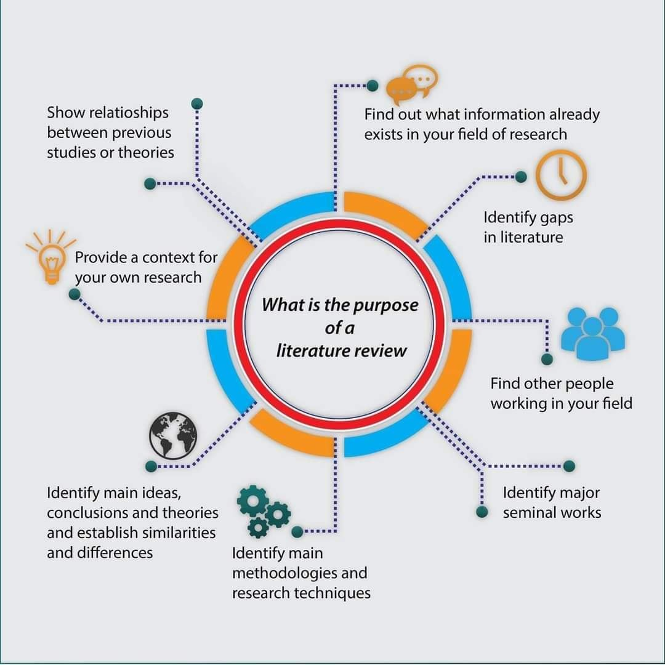
Purpose of Literature Review

Slide 5
Purpose of Literature Review
To avoid the ambiguity of research problems
To ensure the chosen research problems are researchable
To depict the “intellectual environment” of the research problems
To acknowledge the intellectual social network related to the research problems

Slide 6
How to Find Relevant Literatures?
Search with the key‐word of the research topic.
Use broader key‐word (term) if the documents retrieved are few or none.
Use narrower key‐word if the documents retrieved are too much.
Use synonym or related terms to enhance the search
Employ Boolean operator: AND, OR, NOT to control the search
Pick the most recent and related article to start with.
Start look for another related articles through:
New search terms found in the related articles
List of references in the chosen article
SEC: I

Slide 7
Sources
The following types of sources can be used to prepare a bibliography:
a. Books
Textbooks: used in undergraduate and postgraduate courses and in training people to enter a certain profession
Reference books: These books might include ‘dictionary’, ‘encyclopedia,’ ‘reference’ in the title and commonly contain an alphabetically ordered index of terms.
Research books (Monographs): written by experts in the research field. The target audience is a small, more specialised academic community and the books contain higher level information on a specific topic.

Slide 8
Sources ...contd.
b. Journals
Full articles
Short communications/letters: confined to the publication of new but minor discoveries, however, some short communications are used as a mechanism to gain speedy publication of new ideas. Letters have limited explanations, descriptions and a smaller number of references. Letters are usually published much more rapidly than full papers.
Conference papers: Conferences are meetings of researchers with the aim of updating and reporting research developments not yet published. The papers are released to attendees at the conference as ‘conference proceedings’. This is the printed record of the conference.
d. Technical reports

Slide 9
Sources ...contd.
e. IP/patents: A patent is a document written to protect an idea for commercial advantage and exploitation. The object of a patent is to protect an invention or innovation against commercial theft whereby one company makes a profit from an invention by another person or company.
f. Standards: a document that defines a particular experimental technique or a requirement specification. Standards can also be used to define engineering terms so that the profession uses terms in a well-accepted and defined way.
e.g. International Organization for Standards (ISO), and the International Electrotechnical Commission (IEC).
g. Thesis/dissertations
h. Internet.

Slide 10
Sources ...contd.
“Popular” publications should not be included e.g. Newspapers, news magazines, or industry or popular publications.
Even well respected publications, such as the Wall Street Journal, or The Economist are not appropriate sources for a literature review.
Most publishers are making their products accessible online (subject to subscription)
Reference databases are also available online
There is a trend in Universities to subscribe packages guaranteeing access to contents from multiple publishers.
AIUB offers its students access to a range of online journals, viz.,…

Slide 11
Access to Sources
Typically title of scientific journals
Journal of ... (Journal of Symbolic Logic)
Annals of ... (Annals of Pure and Applied Logic)
Archive of ... (Archive of Mathematical Logic)
Transactions of ... (ACM Transactions on Human-Computer Interaction)
Acta ... (Acta Informatica)
Many more ...
SEC: N

Slide 12
Access to Sources
Scientific publishers: Nature, Elsevier, Springer, Taylor & Francis, Wiley Inc., McGraw Hill, etc.
Technical societies also publish prestigious journals, viz.
IEEE (ieeexplore.ieee.org),
ASME (http://asmedigitalcollection.asme.org/journals.aspx),
ACM (https://www.acm.org/publications/journals), etc.

Slide 13
Access to Sources
Open access journals produced by scientific community are becoming increasingly popular
Google Scholar offers wide and extensive access to numerous articles via-
http://scholar.google.com/
Journal database:
ISI (http://mjl.clarivate.com/)
Scopus (www.scopus.com)
Patents:
http://www.uspto.gov/
PCT Applications:
http://www.wipo.int/pctdb/en/

Slide 14
Reliability of Sources
Is it coming from a prestigious journal?
Was it presented in a serious peer-reviewed conference?
Are there other related references?
Is it from a recognized group?
Use Wikipedia with caution
A good starting point to get a general idea
But then seek more reliable and identified sources.
SEC:L

Slide 15
Steps of Literature Review
Key word searching
Selection of relevant papers (partly influenced by
publication date)
3. Review of paper abstracts for relevance
4. Review of the complete papers of relevance
Critical analysis of the results as they apply to the new
research project

Slide 16
Key Words
These are individual words and phrases which describe the topic you are studying. Selecting good key words is very important
if too limited, you may overlook relevant literature
if too broad, you may spend time locating and reviewing literature with little relation to your topic
Start with broad key words, then narrow to a more confined list

Slide 17
Key Words ...contd.
Focus on key words and phrases which define the topic
includes words relevant to the problem, objectives, conceptual framework and methods or procedures.
If you are not yet very familiar with the subject, try to identify first review papers (or even books) that give a general overview of the topic. Then turn to journal articles and then to conference papers.
Try to select a set of 40 – 50 articles in order to help you get a first view of the topic.

Slide 18
Reading
It is often useful to start reading with the most recent publications. This allows:
Focusing more quickly on current knowledge,
Recent research often includes references to relevant earlier research
Note the following in research articles:
The relevance of the article to their research project;
The research methods described in the article;
The conclusions reached at the end of the article; and
The relationship of the article to other publications.

Slide 19
Reading ...contd.
Start elaborating a literature map, which gives you a visual picture of groupings of literature per subtopic.
Prepare short summaries of the key ideas conveyed by each relevant article
Plan a structure for the literature review synthesis; think of original ways of summarizing the ideas (what can be your added-value).

Slide 20
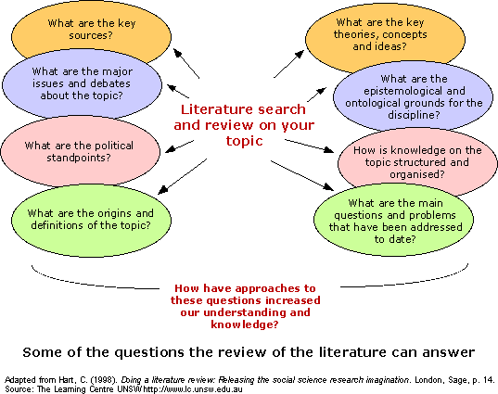
Reading ...contd.

Slide 21
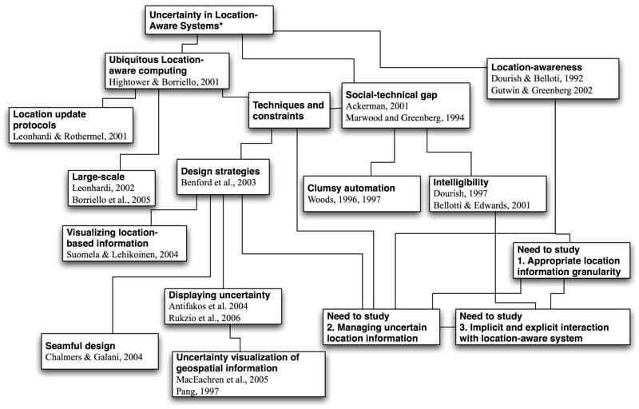
Reading ...contd.

Slide 22
Reading ...contd.
Have a complete citation of each source.
Keep written notes – don’t rely on memory.
Be thorough and systematic in keeping notes; note problem, objectives, methods, findings and conclusions
Note questions, shortcomings or problems with the study.

Slide 23
How to Review Literatures?
Compare: try to find the similarities among literatures
Explain how each article similar to the others.
Contrast: try to find the differences among literatures
Explain how each article differ to the others
Criticize: put your own opinion on what is written in the literatures
Criticize the strength and weakness of the research
Synthesize: combine several literatures into an idea
Summarize: restate the article with your own words in a concise way

Slide 24
Example
Comparing: “According to research conducted by Andri (1999), the performance of the IRS by using techniques extended Boolean better than using techniques Boolean alone. This is in line with research results previously carried out by the Savoy (1995), Salton (1990), etc”.
Contrasting: “Results of research conducted by Santoso (2006) showed that more constructive learning style adaptive to the use of ICT. This is contrary with other research that says that style positivist more adaptive to the use of ICT (YYYY, 98; XXXX, 2001)”

Slide 25
Synthesis
Integrate a set of ideas that were previously dispersed and turn them into a coherent framework
Clarify concepts that were only partially present in other works
Introduce a new / original (fresh) look into the subject
Identify gaps/unsolved issues
Use synthetic representations – graphics, diagrams, tables, etc

Slide 26
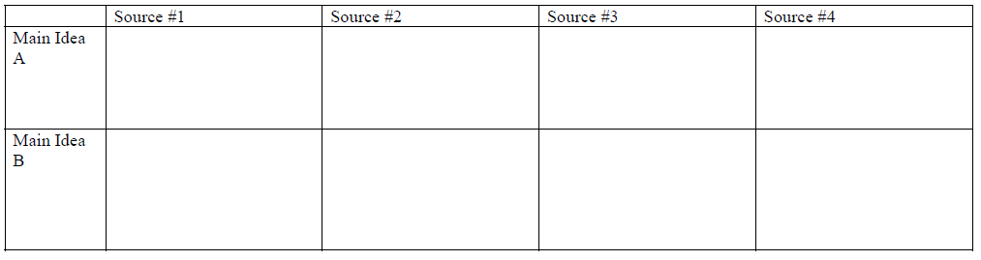
Synthesis ...contd.
Focus on the essential (namely what is relevant for your work)
But at the same time try to give a broad perspective in order to properly “locate” your work
Use following synthesis matrix:

Slide 27
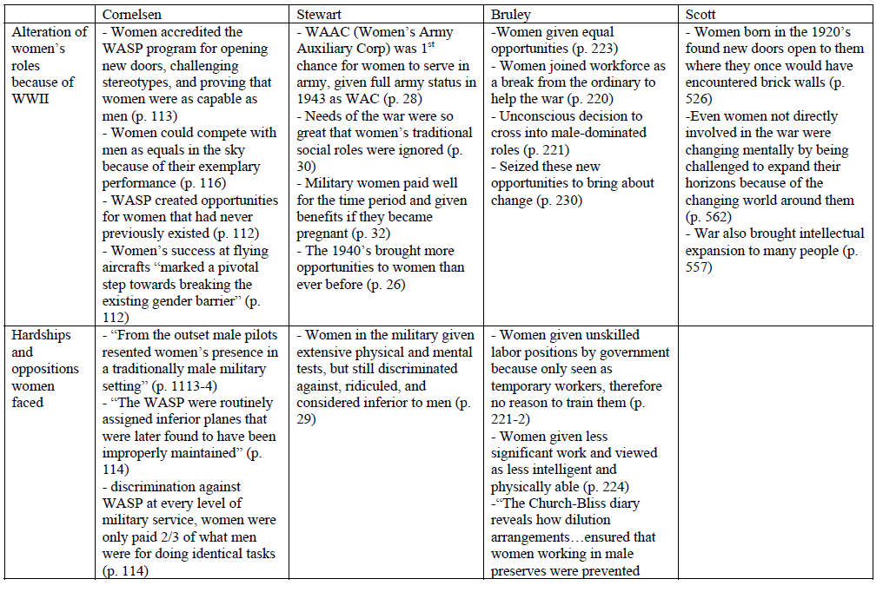
Synthesis ...contd.
E.g. – Women in WWII

Slide 28
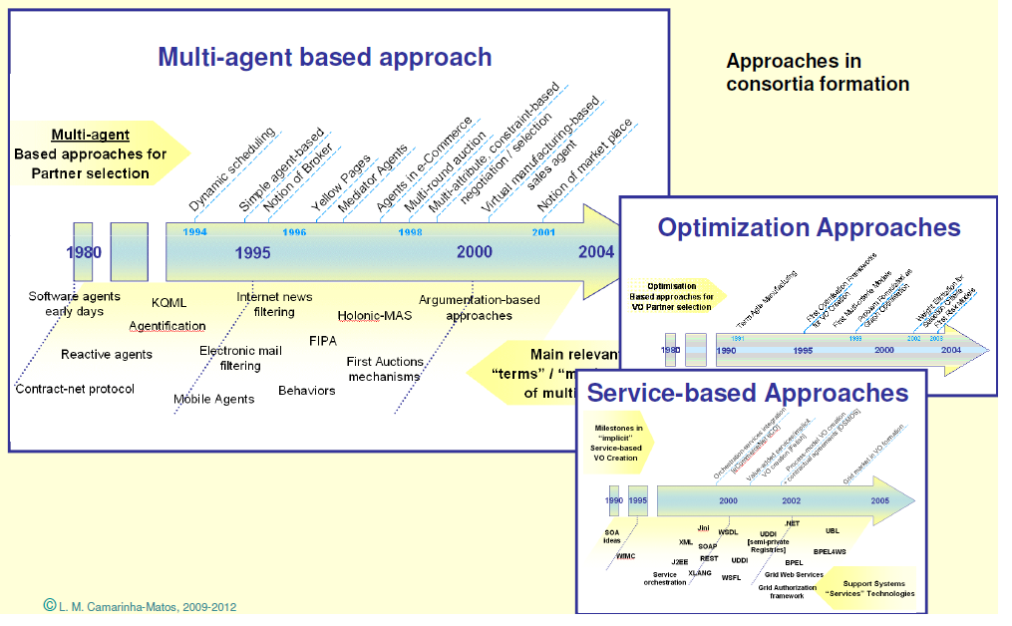
Synthesis ...contd.

Slide 29
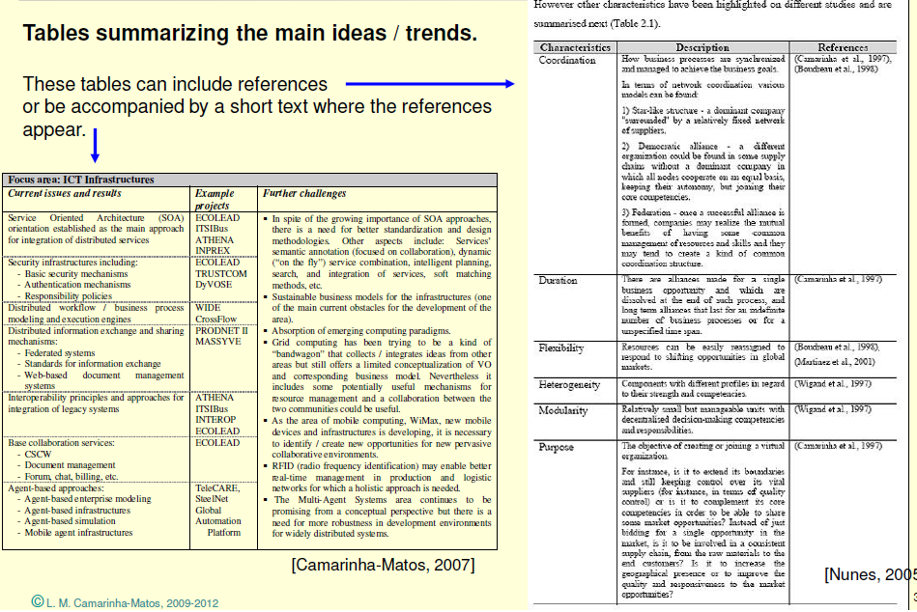
Synthesis ...contd.

Slide 30
What Synthesis is Not
Plagiarism: Definitely not the result of “copy & paste”
Even if properly referenced, what is the relevance?
Copying sentences and making small changes is not acceptable
Not a simple (weakly linked) concatenation of excerpts from others
“Author X said bla bla.... On the other hand, Y defends that bla bla ... Furthermore Z introduced bla bla .... and W agrees with ....”
Not a pedagogic text book

Slide 31
Getting Started
Like many tasks, reading and starting to write review literature usually seems worst before you begin
So you should make a start
1. First make up an outline—just sit and type points to review
2. Organization. It is encouraging and helpful to start a filing system
3. Timetable. a list of dates for when you will give the first and
second drafts
4. Iterative. it is easier, however, to improve something that is
already written than to produce text from nothing

Slide 32
Partial example of literature review
The title of the article:
“A Dynamic Framework for Classifying Information System Development Methodologies and Approaches “

Slide 33
Abstract
This paper proposes a four-tiered framework for classifying and understanding the myriad of information systems development methodologies that have been proposed in the literature. The framework is divided into four levels: paradigms, approaches, methodologies, and techniques. This paper primarily focuses on the two intermediate levels: approaches and methodologies. The principal contribution of the framework is in providing a new kind of "deep structure" for better understanding the intellectual core of methodologies and approaches and their interrelationships. It achieves this goal by articulating a parsimonious set of foundational features that are shared by subsets of methodologies and approaches. To illustrate how the framework's deep structure provides a better understanding of methodologies' intellectual core, it is applied to eleven examples. The paper also introduces and illustrates a procedure for "accommodating" and "assimilating" new information systems development methodologies in addition to the eleven already discussed. This procedure provides the framework with the necessary flexibility for handling the continuing proliferation of new methodologies.

Slide 34
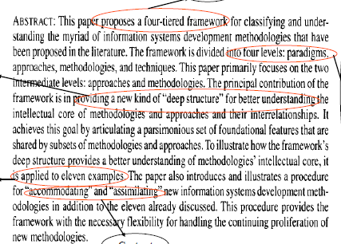
Cr
i
t
i
ze
Synthesis
S
u
m
m
a
r
i
z
e
C
o
m
P
a
r
e
Contrast

Slide 35
Where to Place Your Literature Review?
Usually it’s placed at Chapter 2 of your thesis or dissertation.
A literature review may constitute an essential chapter of a thesis or dissertation.
Literature review should logically connected to research problems, research methodology, analysis and conclusion.

Slide 36
EXAMPLES:
Calise et al. (2015) developed an Organic Rankine Cycle (ORC) working in conjunction with a concentrating photovoltaic/thermal (CPV/T) solar collector that produces electricity and heats diathermic oil simultaneously. The authors used TRNSYS software to evaluate the performance of the hybrid CPV/T collector and ORC system and found CPV/T only system to be more economical.
Li et al. (2015) performed a numerical and experimental investigation on building integrated PV/T system with static miniature solar concentrators. The maximum thermal efficiency, as reported by the authors, was 37.2% with a water outlet temperature of 56.9ºC in the month of September.
Renno fabricated high concentration PV/T system using point-focus parabolic mirror concentrators and triple-junction cells (InGaP/InGaAs/Ge) governed by a dual axis tracker [3]. The water outlet temperature obtained was about 90ºC which is enough to run an auxiliary heat pump.

Slide 37
Referencing
Referencing previous literature occurs throughout research proposal and research reports, but is used most in the literature review.
We reference other literature to:
Provide supporting (or contrary) evidence for the views we write about
Assign credit for an idea, concept or result
Add information and details on matters discussed

Slide 38
Referencing ...contd.
The style used in referencing may vary with the type of publication, as well as your personal preference.
Footnotes (notes at the bottom of the page) or Endnotes (similar notes placed at the end of the paper) can be used, if allowed.
Most commonly used is parenthetical referencing, which provides the author’s last name, year of publication, and sometimes the page number. E.g. (Ethridge, 2004, p.122)
The cited references then all appear in the Reference section at the end of the paper.
SCE:F

Slide 39
Referencing ...contd.
Another possible style is to use a number in parentheses, e.g. (4), with a numbered references list at the end of the paper.
Many different styles are used for the References section. It is best to refer to the style used by the agency or publication to which you are submitting the paper.
e.g. Ethridge, Don. 2004. Research methodology in applied economics. Ames, IA: Blackwell Publ.
Finally, the referencing of internet sources is not fully resolved. Generally, include the full web address and date of access of the website.

Slide 40
examples:
H. Abu-Amar and J. Lokre “Election In Asyncrouns Complete Network With Intermitted Link Failures” IEEE Transaction on Computers, vol. 43, no. 7, pp.778-788, 1994.
M. Hasanuzzaman, A.Q. Al-Amin, S. Khanam, M. Hosenuzzaman, Photovoltaic power generation and its economic and environmental future in Bangladesh, J. Renew. Sustain. Energy 7 (1) (2015) 1-12.
Alvarez, A., Muñiz, M.C., Varela, L.M., 2010. Experimental and numerical investigation of a flat-plate solar collector. Energy 35, 3707–3716.
Hasanuzzaman, M., Al-Amin, A. Q., Khanam, S., and Hosenuzzaman, M., 2015, “Photovoltaic Power Generation and Its Economic and Environmental Future in Bangladesh,” J. Renewable Sustainable Energy, 7(1), pp. 1–12.

Slide 41
Some referencing tools:
EndNote software: www.endnote.com
ReferenceManager: www.refman.com/
ProCite: www.procite.com
Biblioscape: www.biblioscape.com/biblioscape.htm
Bibliographix: http://home.mybibliographix.com/
Mendeley: https://www.mendeley.com/

Slide 42
Conclusion
Literature review is not –
An annotated bibliography
A book or review article
An article summary or critique
A survey of literature
Literature review is –
Your argument which you present by reading, analysing, evaluating and synthesizing
a book of work you have critically selected that is relevant to your problem statement
wherein you present new developments, gaps, directions, changes which shows your contribution to the field

Slide 43
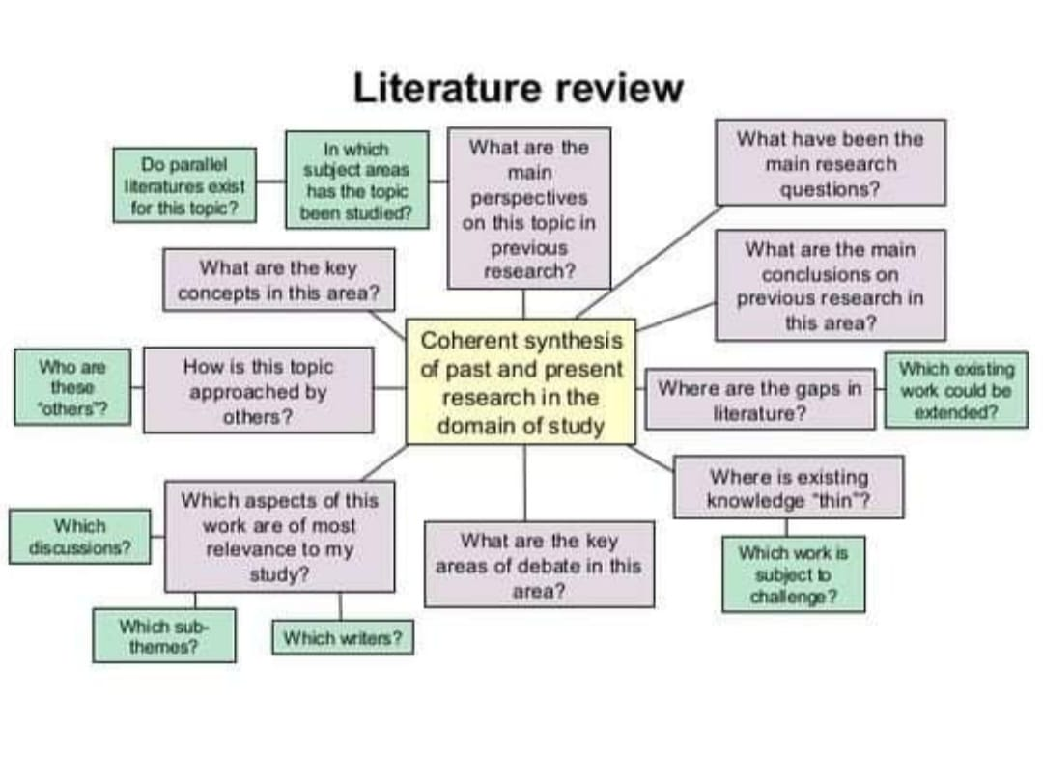

Slide 44
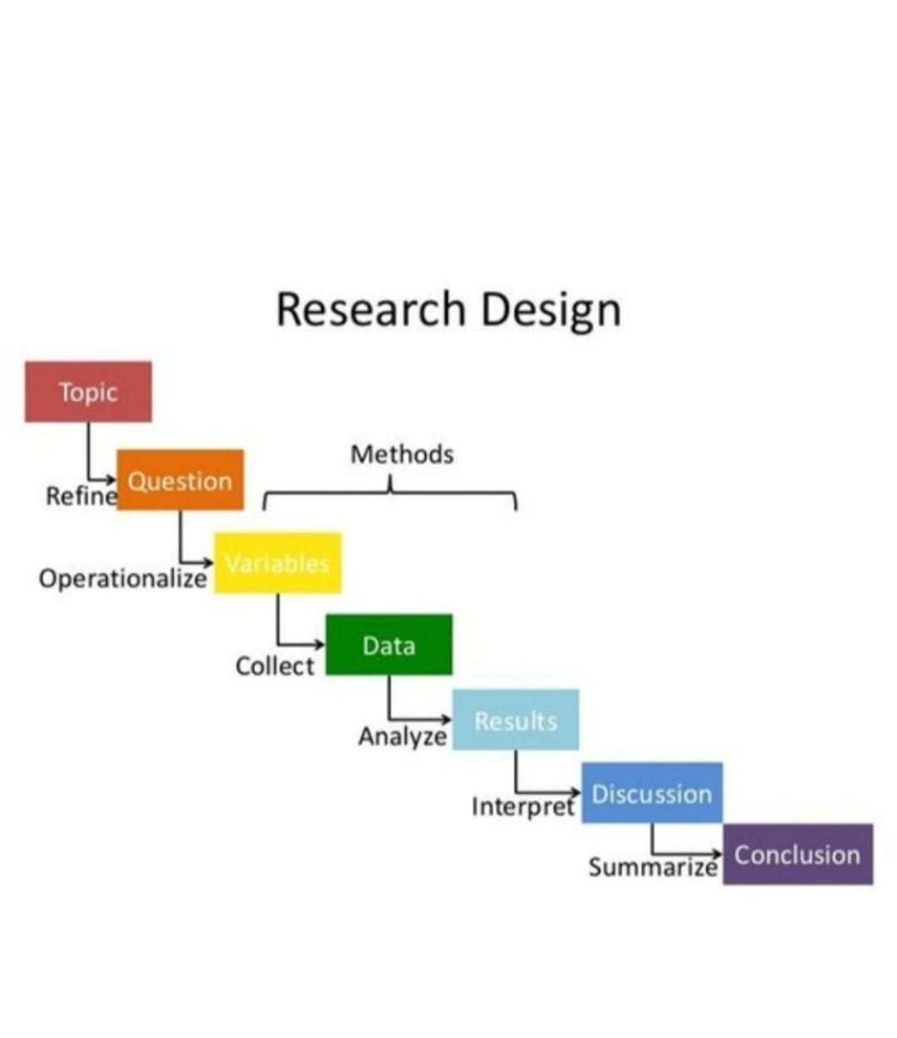
Research Design

Slide 45
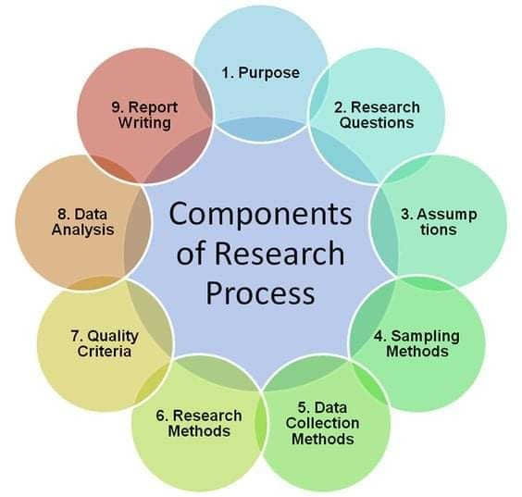

Slide 46
Home Work
Test your literature reviewing quality:
Using a journal paper selected in your cs discipline of interest, write a 400 word evaluation of the quality of the literature review. In particular.
The quality and relevance of the cited papers,
The comments made on those papers’ contribution to the general field.

